Slide 1

LA’FLAUER
DECOR

Slide 2
CREATORS
Syed Afnan Ali
01
ID : 751-2023
EMAIL: Syedafnan03002240@gmail.com
02
Hammad Khanzada
ID : 724-2023
EMAIL:
viperfortnite0@gmail.com
03
Syed Hamza Aziz
ID : 675-2023
EMAIL: muhammadyahya2818@gmail.com

Slide 3
CONTENTS
Introduction and Background Research
Problem Statement
Aim And Objective
Research Design
Simulation Result
Features of proposed system
Conclusion Suggestion And Question

Slide 4
Introduction and Background research
LaFleur Décor is an eCommerce website designed to sell rare and unique flowers to customers around the world. The main goal of the project is to make rare flowers more accessible through user-friendly online platform. The website is built using HTML, CSS, PHP, and MySQLand includes important features like a shopping cart, session handling, and a working contact form. During background research,it was found that many existing flower websites focus only on common flowers and lack key features such as proper cart systems, session management,and working contact forms. LaFleur Décor aims to solve these problemby providing a complete and reliable online flower shopping experience.
Regards

Slide 5
Problem Statement
Many online flower websites only offer common flowers and lack important features like a proper shopping cart, session handling, and a working contact form. Customers often face difficulty in saving items, placing orders, or contacting sellers. Also, rare flowers are not easily available online. There is a need for a user-friendly website that can provide rare flowers, ensure smooth online shopping, and allow easy communication between buyers and sellers.

Slide 6

Aims and Objective
The main aim of this project is to create an eCommerce website that provides rare and unique flowers to customers worldwide. The goal is to offer a smooth and user-friendly shopping experience through features like a shopping cart, session handling, and a working contact form. The website also connects with local flower shops and agents to deliver rare flowers easily. This project aims to fill the gap in the market by offering something that most flower websites do not provide.

Slide 7
Objectives
Sell rare flowers online that are not easily available in the local market.
Work with special agents who help us find and provide these rare flowers.
Connect the system with nearby flower shops to make delivery faster and easier.
Create a simple and beautiful design using HTML and CSS.
Use PHP and MySQL for backend work like saving orders, customer details, and contact messages.
Add a shopping cart system where customers can add or remove flowers before checkout.
Handle user sessions so each customer can safely use the website during their visit.
Build a working contact form so users can easily send messages or ask questions.
Make the site mobile-friendly so it works well on phones and other devices.

Slide 8

Research Design
The research design for LaFleur Décor focuses on understanding the needs of users who want to buy rare flowers online. We studied different eCommerce flower websites to identify their strengths and weaknesses. Most websites lacked features like shopping carts, session handling, or reliable contact forms. Based on this research, we planned a website that fills these gaps by including all essential features. We chose tools like HTML, CSS, PHP, and MySQL for development, and used VS Code as our coding platform. The system is designed to work smoothly on modern browsers, especially Google Chrome.

Slide 9
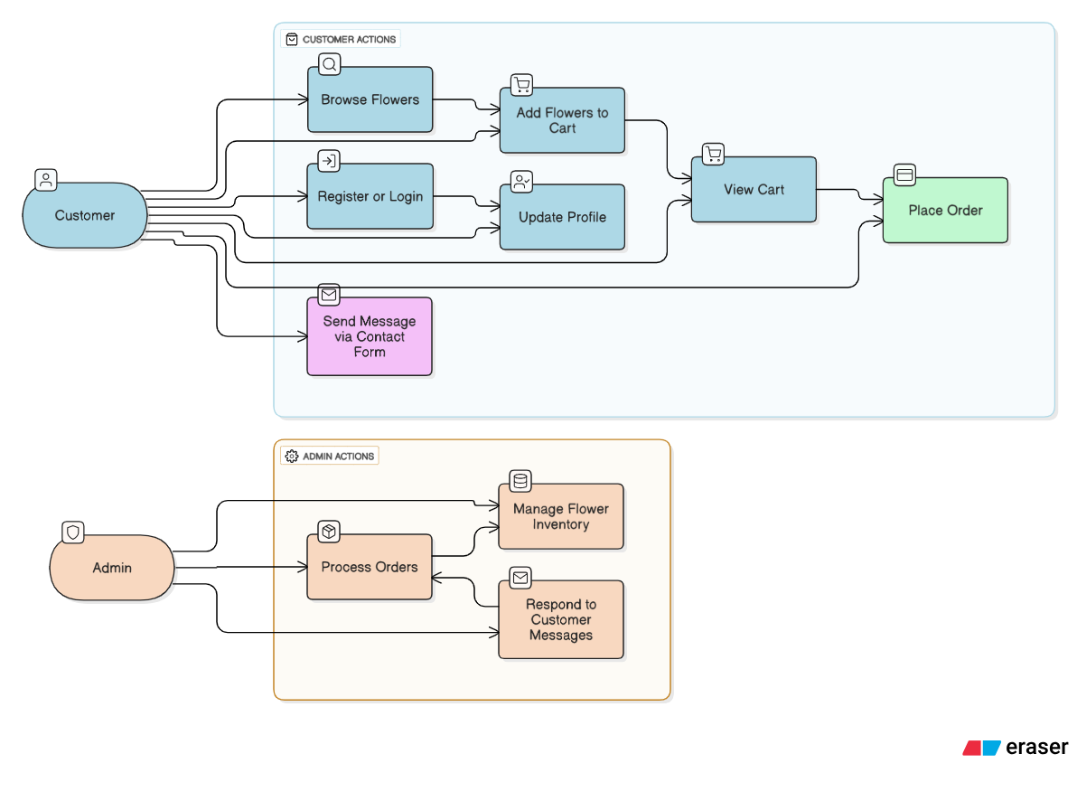
Simulation Result

Slide 10
Feature of Proposed System
The proposed system offers several useful features to improve the online flower shopping experience. It includes a shopping cart system where users can easily add or remove flowers before placing an order. It has session handling to keep users logged in and save their cart items during their visit. The website provides a working contact form so customers can reach out to the seller easily. It also connects with local flower shops and agents to supply rare flowers that are not commonly available. The site is designed to be user-friendly, responsive, and works well on modern browsers.

Slide 11
Conclusion
LaFleur Décor is a user-friendly website designed to sell rare flowers online. It includes useful features like a shopping cart, session handling, and a contact form to improve the customer experience. The system helps users find and order unique flowers easily and connects with local shops for quick delivery. This project has helped us learn how to build and manage an eCommerce platform using web development and database tools.

Slide 12
THANK YOU
Any
Quetion /Suggestion

